Slide 1
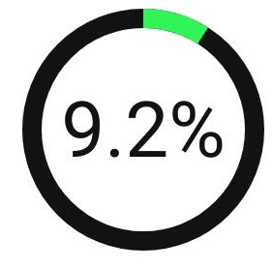
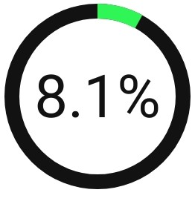

Team Name : CodingDovahhe
Cisco DEVNET
Problem Code : AM289
Atithi Devo Bhava (A Virtual Travel Agent)
Problem Statement : Fusing the power of WebEx platform with MindMeld AI with the current tourism industry to boost tourism in India .
The major inconvenience for a frequent traveller is to keep switching to a variety of apps resulting in very confusing and tedious user experience.
Why is tourism so important to India?
What needs Considerations?
Tourism revenue not at par with other countries.
Changing trends in tourism
Untapped business opportunities
Hospitality Level
Tourist Awareness
Tourism marketing strategies
TOTAL EMPLOYMENT
Supported 42.673 million jobs in 2018
INDIA’s GDP
Generated ₹16.91 lakh crore
ANNUAL GROWTH RATE
In International tourist arrivals(2019)

Slide 2
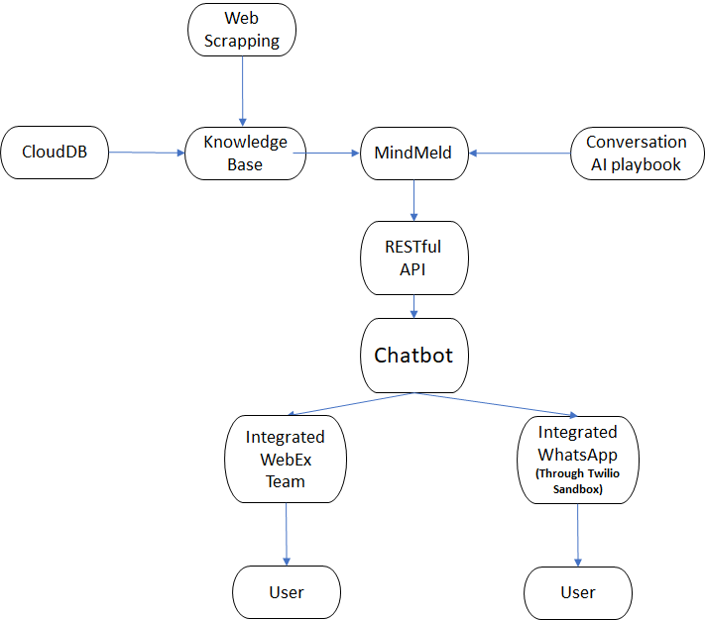
Team Name : CodingDovahhe
Cisco DEVNET
Problem Code : AM289
Atithi Devo Bhava (A Virtual Travel Agent)
Solution : Tourists often get overwhelmed by the choices present to them. Thus a need arises to develop a context-based NLP chatbot to provide an all in one feature to the tourists.
Solution Overview:
Conversational AI-chatbot to guide tourists
Personalized multilingual AI ChatBot.
Recommendation - places, hotels, local specialities, beneficial packages for tourism, currency exchange outlets.
Focus on Security
Enhanced travel experience leads to boost of tourism industry.
Technology stack:
Cisco WebEx Platform
MindMeld Conversational AI Playbook
Web Scraping using python
Cloud DB

Slide 3
USE CASE [Adventure Tourism]
Feeling Adventurous
Let's try atithi bot to start my Adventure tour
Uses ChatBot for recommendation of places near him
Planning of journey
Booking Transportation
[Flights,Bus,Train etc]
Booking Hotels
User Gives feedback which is valuable for improving recommendation system of our ChatBot
Traveller arrived at destination
Recommend Local Food,User’s country food, it’s address and it’s Estimated cost
Tourist Attractions (Adventure/Historical)
Estimated time to spend at a tourist location
Estimate price of tickets,local transport (Bus ,Auto) etc. to avoid fraud.

Slide 4
Hierarchy of Classifiers
APP NAME
Atithi
DOMAINS
greeting
faq
general
recommend
[No intents; Contains only knowledge base]
get_theme
get_shops
greet
get_travel
INTENTS
get_location
get_food
get_city
get_transport
exit
get_person_info
get_clinic
get_hotels
theme, Police_Station, city, monuments, vehicles, hotels, clinics, food_items,
local_food, foreign_food, natural_views,
ENTITIES
get_policeStation

